Slide 1
L4
Single Stage(small signal)Transistor
Amplifiers

Slide 2
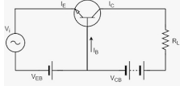
TRANSISTOR AS AN AMPLIFIER L1
A transistor acts as an amplifier by raising the strength of a weak signal. The DC bias voltage applied to the emitter base junction, makes it remain in forward biased condition. ... Thus a small input voltage results in a large output voltage, which shows that the transistor works as an amplifier.

Slide 3
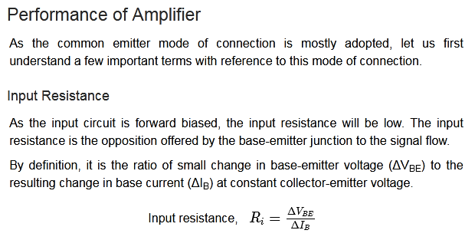

Slide 4
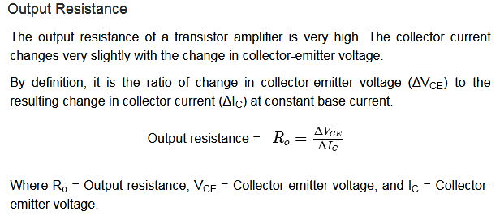

Slide 5
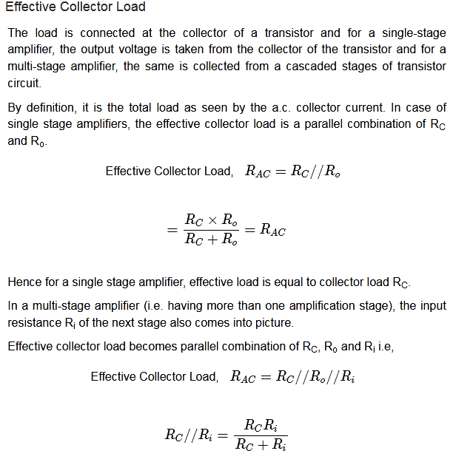

Slide 6
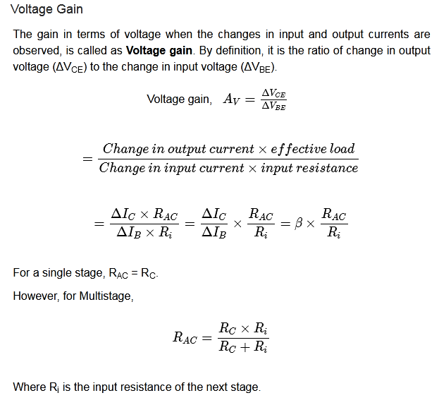

Slide 7
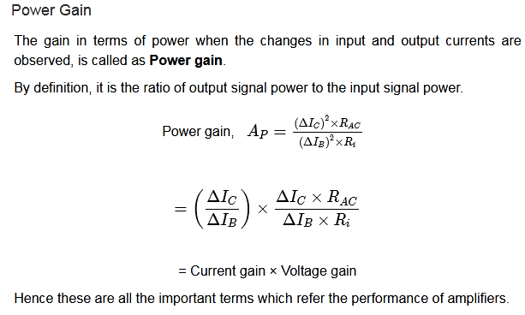

Slide 8
Amplifier Classes
Amplifiers are classified into classes according to their construction and operating characteristics.

Slide 9
Based on the input signals
Depending upon the magnitude of the input signal applied, they can be categorized as Small signal and large signal amplifiers.
Small signal Amplifiers − When the input signal is so weak so as to produce small fluctuations in the collector current compared to its quiescent value, the amplifier is known as Small signal amplifier.
Large signal amplifiers − When the fluctuations in collector current are large i.e. beyond the linear portion of the characteristics, the amplifier is known as large signal amplifier.
Based on its output signals
Depending upon the parameter that is amplified at the output, there are voltage and power amplifiers.
Voltage Amplifiers − The amplifier circuit that increases the voltage level of the input signal, is called as Voltage amplifier.
Power Amplifiers − The amplifier circuit that increases the power level of the input signal, is called as Power amplifier

Slide 10
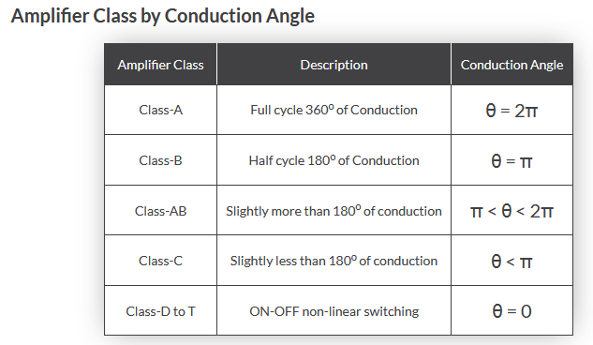

Slide 11
INTRODUCTION
single stage transistor amplifier. By a stage we
mean a single transistor with its bias and auxiliary
equipment. It may be emphasised here that a
practical amplifier is always a multistage amplifier
i.e. it has a number of stages of amplification.
However, it is profitable to consider the multistage
amplifier in terms of single stages that are connected together. In this chapter, we shall confine our attention to single stage transistor amplifiers.
In Another word

Slide 12
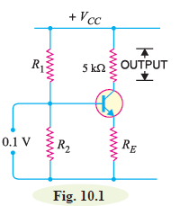
Single Stage Transistor Amplifier
When only one transistor with associated circuitry is used for
amplifying a weak signal, the circuit is known as single stage
transistor amplifier. A single stage transistor amplifier has one
transistor, bias circuit and other auxiliary components. Although
a practical amplifier consists of a number of stages, yet such a
complex circuit can be conveniently split up into separate single
stage by analysing carefully only a single stage and using this single
stage analysis repeatedly, we can effectively analyse the complex circuit. It follows, therefore, that single stage amplifier analysis is of great value in understanding the
practical amplifier circuits.

Slide 13
How Transistor Amplifies ?
Fig. 10.1 shows a single stage transistor amplifier. When a weak a.c. signal is given to the base of transistor, a small base current (which is a.c.) starts flowing. Due to transistor action, a much larger (β times the base current) a.c. current flows through the collector load RC. As the value of RC is quite high (usually 4-10 kΩ), therefore, a large voltage appears across RC. Thus, a weak signal applied in the base circuit appears in amplified form in the collector circuit. It is in this way that a transistor acts as an amplifier. The action of transistor amplifier can be beautifully explained by referring to Fig. 10.1. Suppose a change of 0.1V in signal voltage produces a change of 2 mA in the collector current. Obviously, a signal of only 0.1V applied to the base will give an output voltage
= 2 mA × 5 kΩ = 10V. Thus, the transistor has been able to raise the voltage level of the signal from 0.1V to 10V i.e. voltage amplification or stage gain is 100.

Slide 14
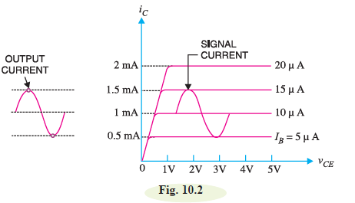
Graphical Demonstration of Transistor Amplifier

Slide 15
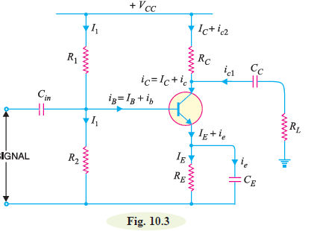
Practical Circuit of Transistor Amplifier
It is important to note that a transistor can accomplish faithful amplification only if proper associated circuitry is used with it. Fig. 10.3 shows a practical single stage transistor amplifier. The various circuit elements and their functions are described below :

Slide 16
(i) Biasing circuit. The resistances R1, R2 and RE form the biasing and stabilization circuit.
The biasing circuit must establish a proper operating point otherwise a part of the negative half-cycle of the signal may be cut off in the output.
(ii) Input capacitor Cin. An electrolytic capacitor Cin
(=10 μF ) is used to couple the signal to the base of the transistor. If it is not used, the signal source resistance will come across R2 and thus change the bias. The capacitor Cin allows only a.c. signal to flow but isolates the signal source from R2.*
iii) Emitter bypass capacitor CE. An emitter bypass capacitor CE (=100μF ) is used in parallel with RE to provide a low reactance path to the amplified a.c. signal. If it is not used, then amplified a.c. signal flowing through RE will cause a voltage drop across it, thereby reducing the output voltage.

Slide 17
(iv) Coupling capacitor CC. The coupling capacitor CC (=10μF) couples one stage of amplification to the next stage.
*It may be noted that a capacitor offers infinite reactance to d.c. and blocks it completely whereas it allows a.c. to pass through it*.
If it is not used, the bias conditions of the next stage will be drastically changed due to the shunting effect of RC. This is because RC will come in parallel with the upper resistance R1 of the biasing network of the next stage, thereby altering the biasing conditions of the latter. In short, the coupling capacitor CC isolates the d.c. of one stage from the next stage, but allows the passage of a.c. signal.

Slide 18
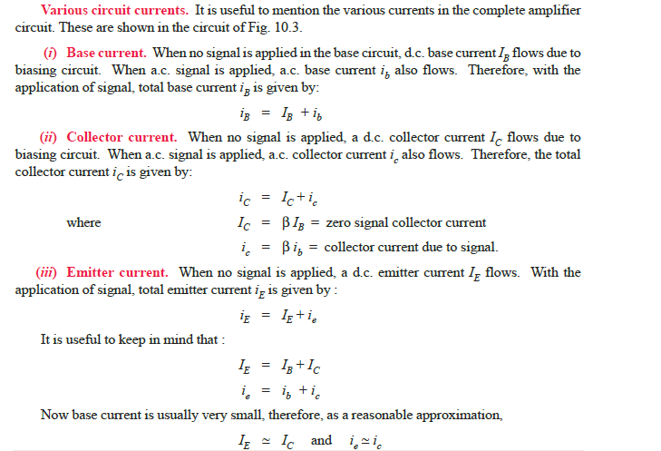

Slide 19
Phase Reversal
In common emitter connection, when the input signal voltage increases in the positive sense, the output voltage increases in the negative direction and vice-versa. In other words, there is a phase difference of 180° between the input and output voltage in CE connection. This is called phase reversal.*
The phase difference of 180° between the signal voltage and output voltage in a common emitter
amplifier is known as phase reversal.
Consider a common emitter amplifier circuit shown in
Fig. 10.5. The signal is fed at the input terminals (i.e. between base and emitter) and output is taken from collector and emitter end of supply.
The total instantaneous output voltage vCE is given by :

Slide 20
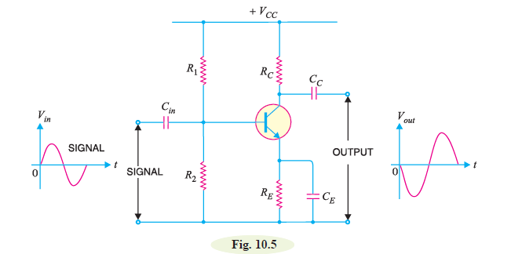

When the signal voltage increases in the positive half-cycle, the base current also increases. The result is that collector current and hence voltage drop iC RC increases. As VCC is constant, therefore, output voltage vCE decreases. In other words, as the signal voltage is increasing in the positive half cycle, the output voltage is increasing in the negative sense i.e. output is 180° out of phase with the input. It follows, therefore, that in a common emitter amplifier, the positive half-cycle of the signal appears as amplified negative half-cycle in the output and vice-versa. It may be noted that amplification is not affected by this phase reversal.
The fact of phase reversal can be readily proved mathematically. Thus differentiating exp. (i),we get,
The negative sign shows that output
voltage is 180° out of phase with
the input signal voltage.

Slide 21
A.C. equivalent circuit.
In the a.c. equivalent circuit of a transistor amplifier, only a.c. conditions are to be considered. Obviously, the d.c. voltage is not important for such a circuit and may be considered zero. The capacitors are generally used to couple or bypass the a.c. signal. The designer intentionally selects capacitors that are large enough to appear as short circuits to the a.c. signal. in order to draw the a.c. equivalent circuit, the following two steps are applied to the transistor circuit :
(a) Reduce all d.c. sources to zero (i.e. VCC = 0).
(b) Short all the capacitors.

Slide 22
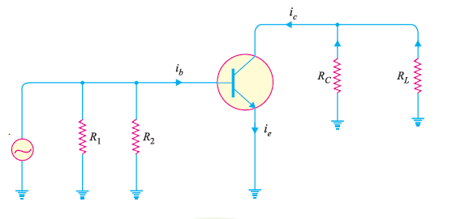
It may be seen that total current in any branch is the sum of d.c. and a.c. currents through that branch. Similarly, the total voltage across any branch is the sum of d.c. and a.c. voltages across that branch.

Slide 23
Multistage Transistor Amplifiers introduction
Many applications cannot be handle with single-transistor amplifiers in order to meet the specification of a given amplification factor, input resistance and output resistance.
As a solution – transistor amplifier circuits can be connected in series or cascaded amplifiers
This can be done either to increase the overall small-signal voltage gain or provide an overall voltage gain greater than 1 with a very low output resistance .
OR

Slide 24
Multistage Transistor Amplifiers
A transistor circuit containing more than one stage of amplification is known as multistage transistor amplifier In a multistage amplifier, a number of single amplifiers are connected in *cascade arrangement i.e. output of first stage is connected to the input of the second stage through a suitable coupling device and so on. The purpose of coupling device(e.g. a capacitor, transformer etc.) is:
to transfer a.c. output of one stage to the input of the next stage and
(ii) to isolate the d.c. conditions of one stage from the next stage.

Slide 25
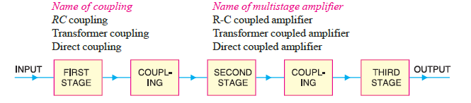
(i) In RC coupling, a capacitor is used as the coupling device. The capacitor connects the
output of one stage to the input of the next stage in order to pass the a.c. signal on while blocking the d.c. bias voltages.
(ii) In transformer coupling, transformer is used as the coupling device. The transformer coupling
provides the same two functions (viz. to pass the signal on and blocking d.c.) but permits in addition impedance matching.
(iii) In direct coupling or d.c. coupling, the individual amplifier stage bias conditions are so designed that the two stages may be directly connected without the necessity for d.c. isolation.

Slide 26
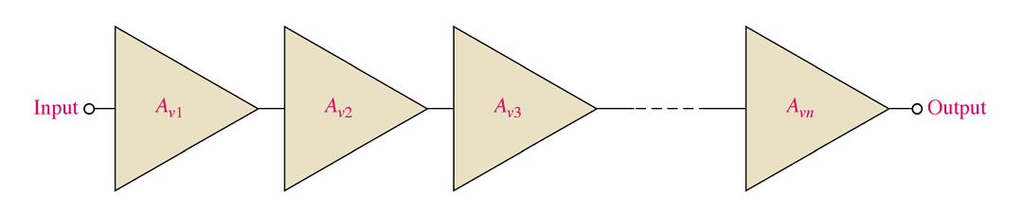
Multistage Amplifiers
Two or more amplifiers can be connected to increase the gain of an ac signal. The overall gain can be calculated by simply multiplying each gain together.
A’_{v} = A_{v1}A_{v2}A_{v3} ……
Notes:
Fig 6-32

Slide 27
Example
Find V_{out}
V_{in} = 5 mV
A_{v1} = 5
A_{v2} = 10
A_{v3} = 6
A_{vn} = 8
Notes:
Fig 6-32

Slide 28
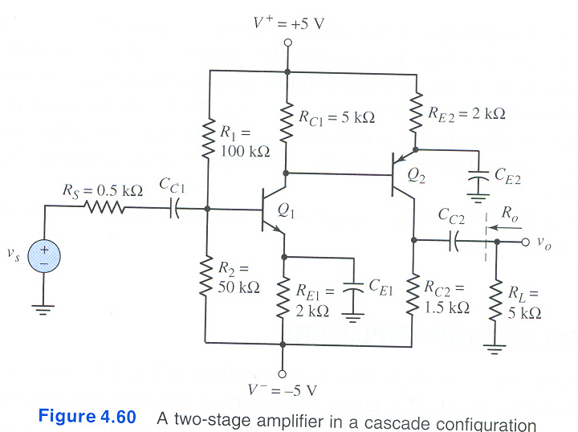
i) Cascade Connection
The most widely used method
Coupling a signal from one stage to the another
stage and block dc voltage from one stage to
the another stage
-The signal developed across the collector
resistor of each stage is coupled into
the base of the next stage
-The overall gain = product of the
individual gain
**refer page 219

Slide 29
Role of Capacitors in Transistor Amplifiers
Regardless of the manner in which a capacitor is connected in a transistor amplifier, its behaviour towards d.c. and a.c. is as follows. A capacitor blocks d.c. i.e. a capacitor behaves as an “open**” to d.c. Therefore, for d.c. analysis, we can remove the capacitors from the transistor amplifier circuit.
A capacitor offers reactance (= 1/2πfC) to a.c. depending upon the values of f and C. In practical transistor circuits, the size of capacitors is so selected that they offer negligible (ideally zero) reactance to the range of frequencies handled by the circuits. Therefore, for a.c. analysis, we can replace
the capacitors by a short i.e. by a wire. The capacitors serve the following two roles in transistor
amplifiers :
1. As coupling capacitors
2. As bypass capacitors

Slide 30
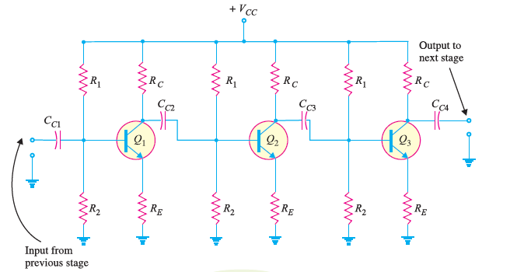

Slide 31
1. As coupling capacitors. In most applications, you will not see a single transistor amplifier.
Rather we use a multistage amplifier i.e. a number of transistor amplifiers are connected in series or
cascaded. The capacitors are commonly used to connect one amplifier stage to another. When a
capacitor is used for this purpose, it is called a coupling capacitor. Fig. 11.2 shows the coupling
capacitors (CC1; CC2 ; CC3 and CC4) in a multistage amplifier. A coupling capacitor performs the
following two functions :
(i) It blocks d.c. i.e. it provides d.c. isolation between the two stages of a multistage amplifier.

Slide 32
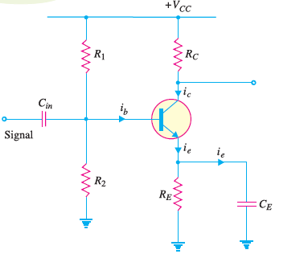
(ii) It passes the a.c. signal from one stage to the next with little or no distortion.
2. As bypass capacitors. Like a coupling
capacitor, a bypass capacitor also
blocks d.c. and behaves as a short or wire
(due to proper selection of capacitor size)
to an a.c. signal. But it is used for a different purpose. A bypass capacitor is connected in parallel with a circuit component (e.g. resistor) to bypass the a.c. signal and hence the name. shows a bypass capacitor CE connected across the emitter resistance RE. Since CE behaves as a short to the a.c. signal, the whole of a.c. signal (ie) passes through it. Note that CE keeps the emitter at a.c. ground.

Slide 33
Thus for a.c. purposes, RE does not exist. We have already seen in the previous chapter that CE plays an important role in determining the
voltage gain of the amplifier circuit. If CE is
removed, the voltage gain of the amplifier
is greatly reduced. Note that Cin is the coupling capacitor in this circuit.
Important Terms
In the study of multistage amplifiers, we shall frequently come across the terms gain,
frequency response, decibel gain and bandwidth.

Slide 34
An integrated circuit
An integrated circuit or IC is basically the assembly of electronic components fabricated on a semiconductor material as a unit. There are different techniques used to design and construct integrated circuits. In today's world, integrated circuits are used in almost all electronic equipment.

Slide 35
vantages of ICs
The discovery of integrated circuits was a huge breakthrough in the field of electronics due to the fact that ICs were a lot more reliable, capable, and cheaper than discrete circuits.

Slide 36
THE BJT AS A SWITCH
BJT can be used as a linear amplifier. The second major application area is switching applications. When used as an electronic switch, a BJT is normally operated alternately in cutoff and saturation. Many digital circuits use the BJT as a switch.
Cutoff =open switch =high resistance =off
Saturation =closed switch =low resistance = on

Slide 37
Switching Operation
The basic operation of a BJT as a switching device.
(a) the transistor is in the cutoff region because the base-emitter junction is not forward-biased. In this condition, there is, ideally, an open between collector and emitter, as indicated by the switch equivalent.
(b), the transistor is in the saturation region because the base emitter junction and the base-collector junction are forward-biased and the base current is made large enough to cause the collector current to reach its saturation value. In this condition, there is, ideally, a short between collector and emitter, as indicated by the switch equivalent. Actually, a small voltage drop across the transistor of up to a few tenths of a volt normally occurs, which is the saturation voltage, VCE(sat).

Slide 38
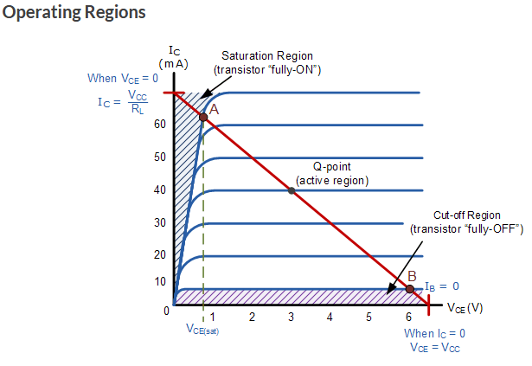

Slide 39
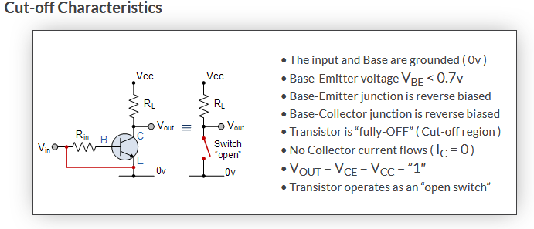

Slide 40
